Slide 1
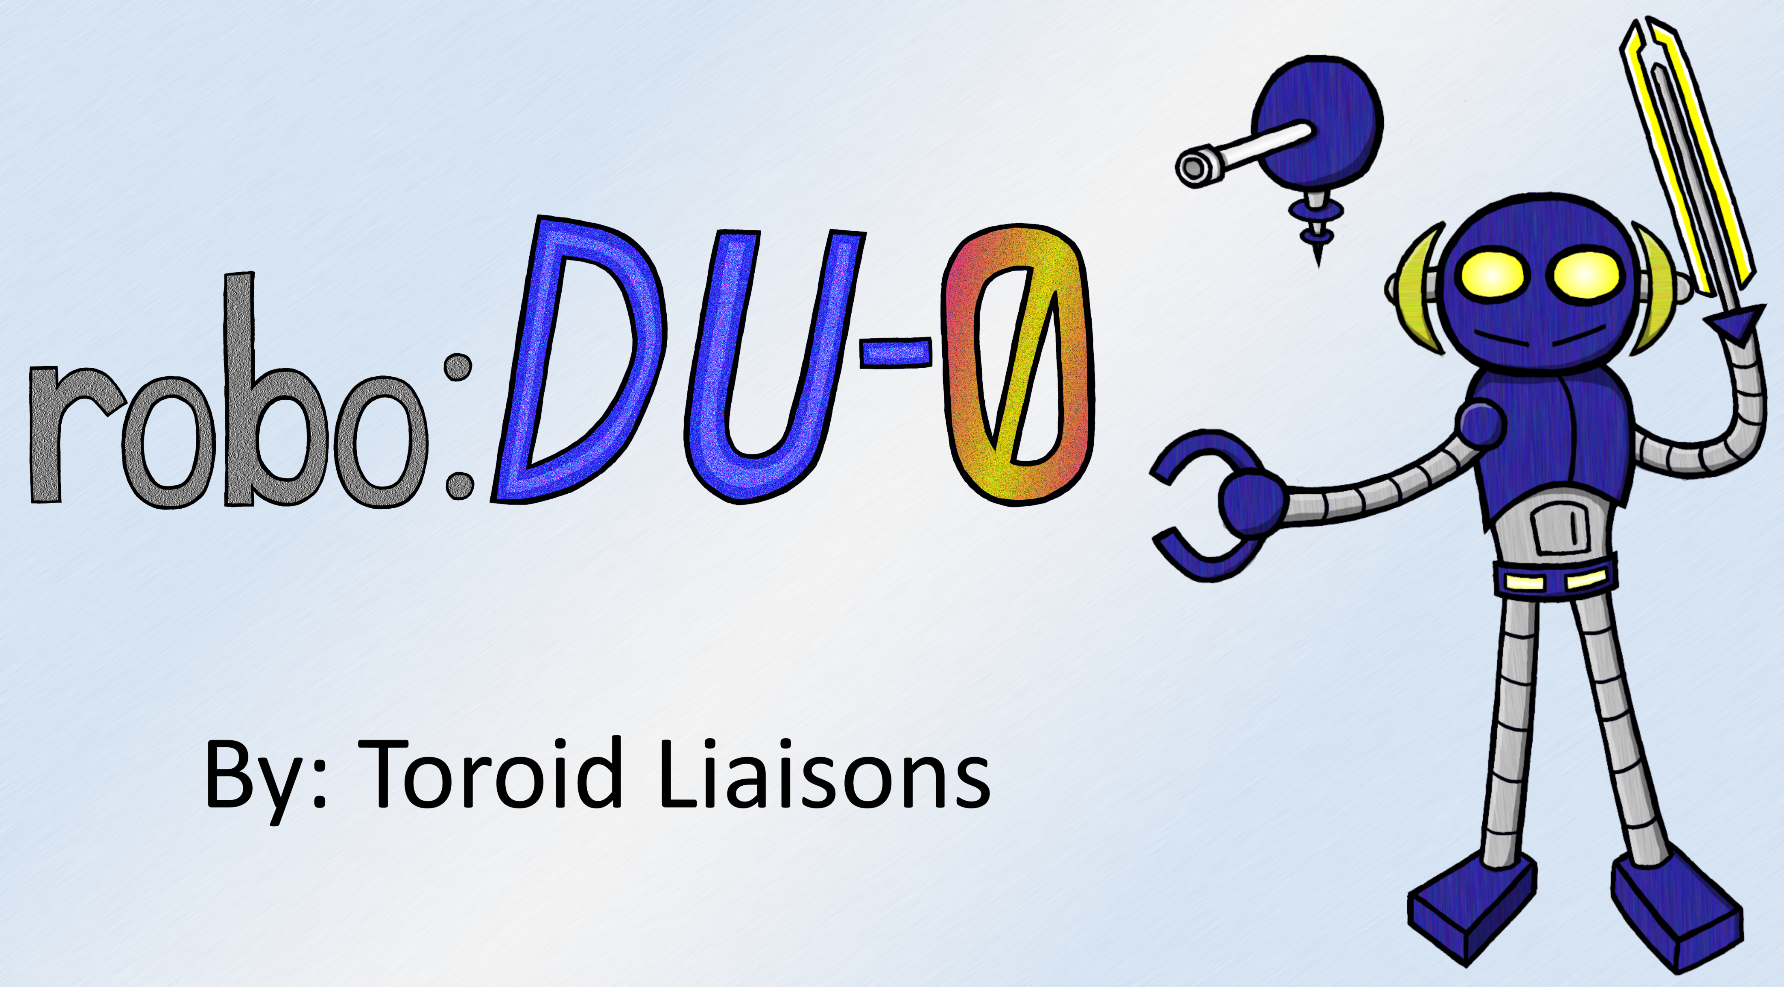

Slide 2
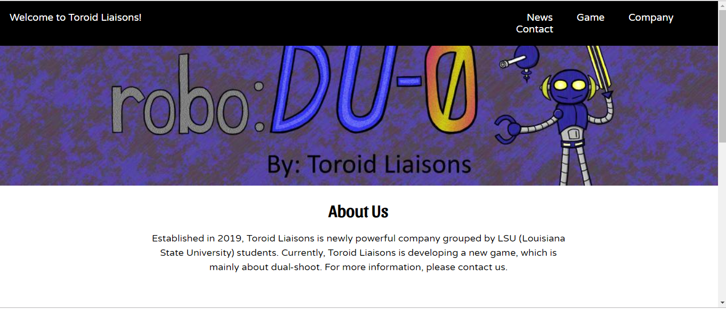
Website
http://helloworld2019.pythonanywhere.com/

Slide 3
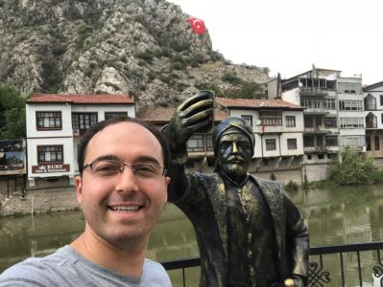

Team Leader / Programmer
Fettah Kiran
Scenario Designer / Programmer
William Harrison

Slide 4
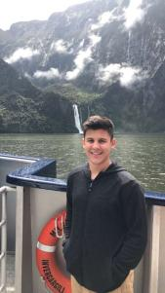
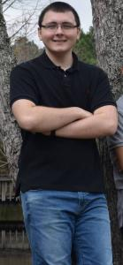
Art Designer
Logan Davis
Sound Designer
Hunter Galtier

Slide 5
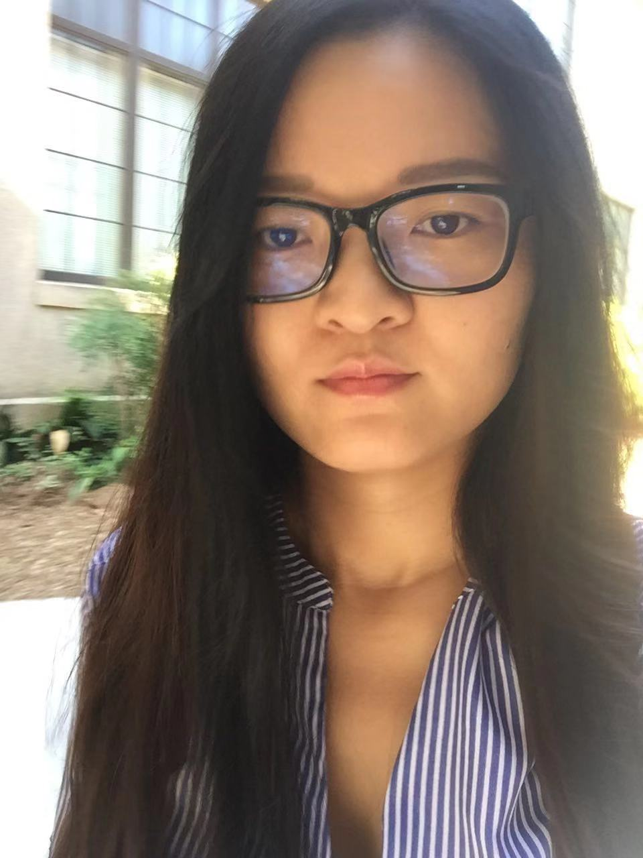
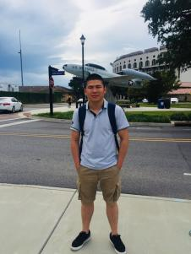
Programmer
Yuqi Ding
Web Designer
Min Cui

Slide 6
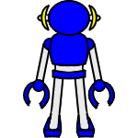
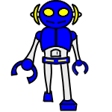

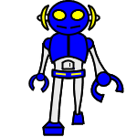
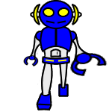
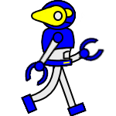
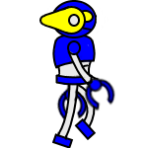
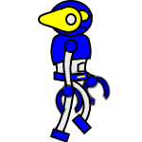
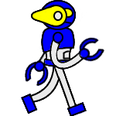
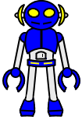
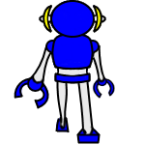

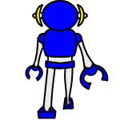

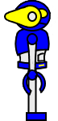












Sprites

Slide 7

Audio
enemy_death_2
toroid_liasons
cyborg_hurt - Part_1
plasma_shot_no_reverb
enemy_death_1
player_hurt

Slide 8
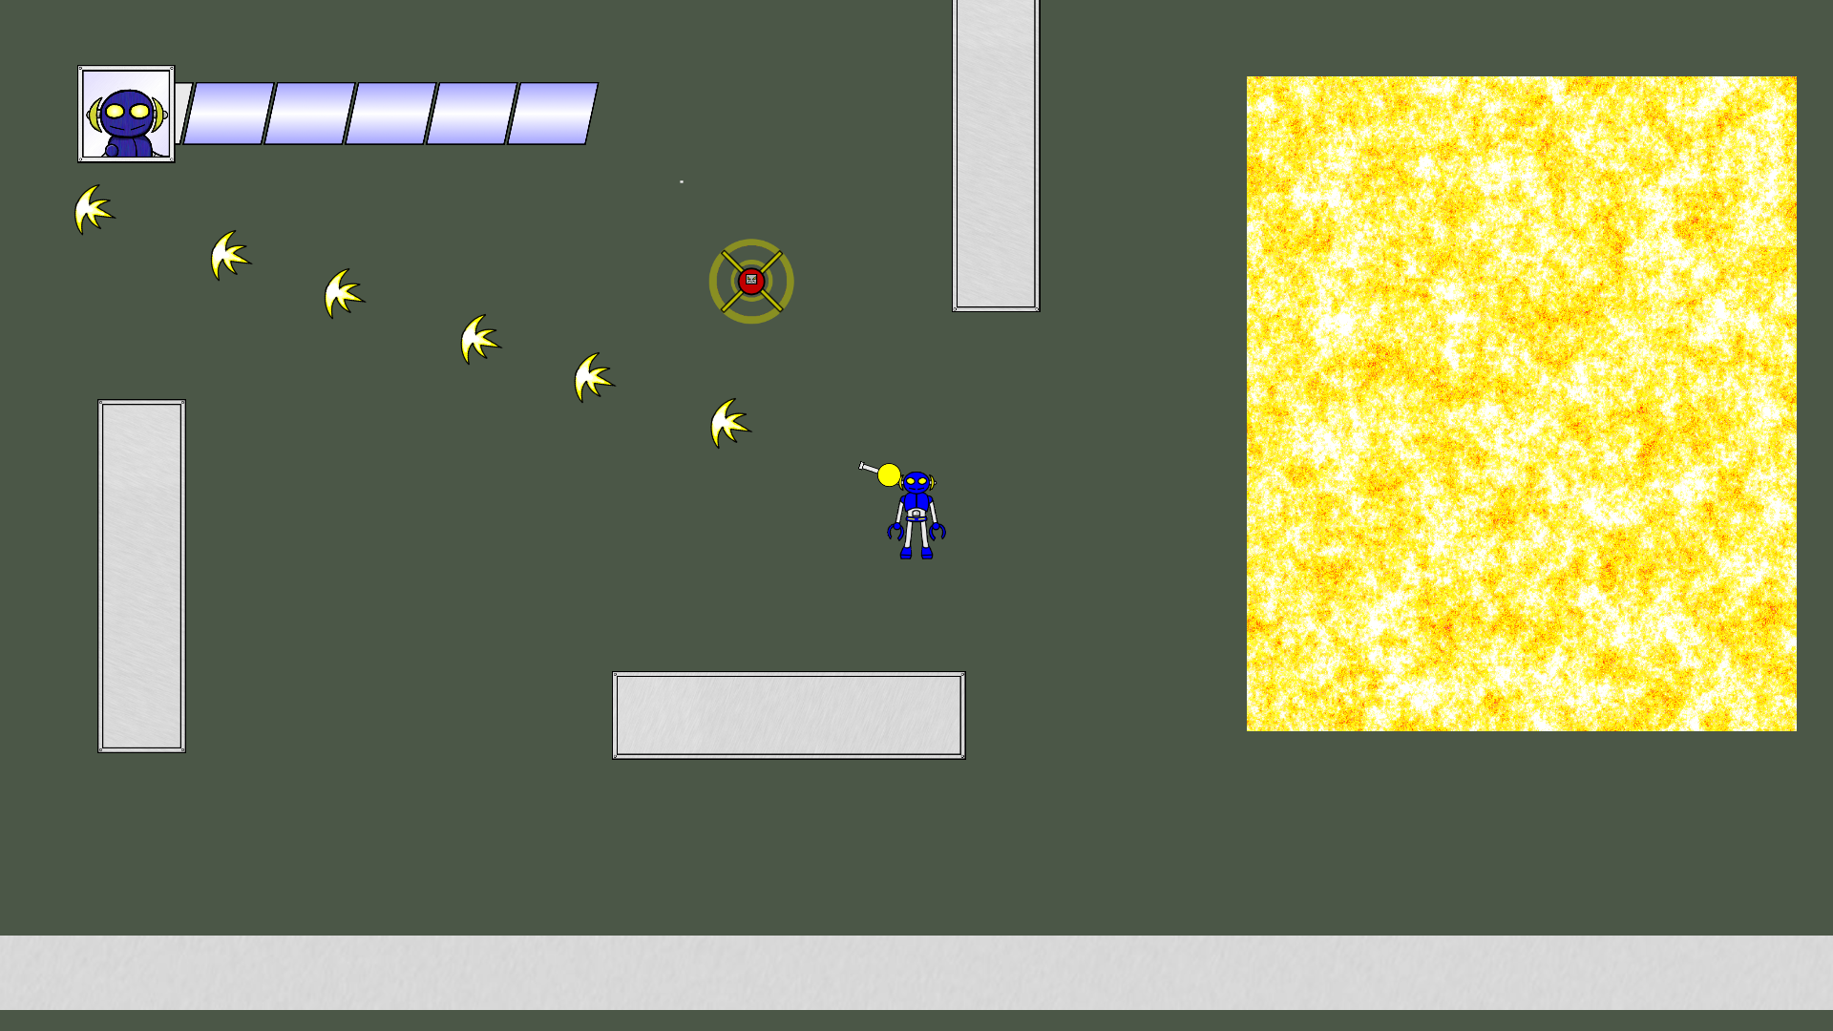
Test Room Demo

Slide 9

Future Goals to Implement
Melee Combat
More Terrain
More in-depth levels
More enemy types with variable AI
Weapon upgrades
Bosses
Animation
Sound Effects

Slide 10
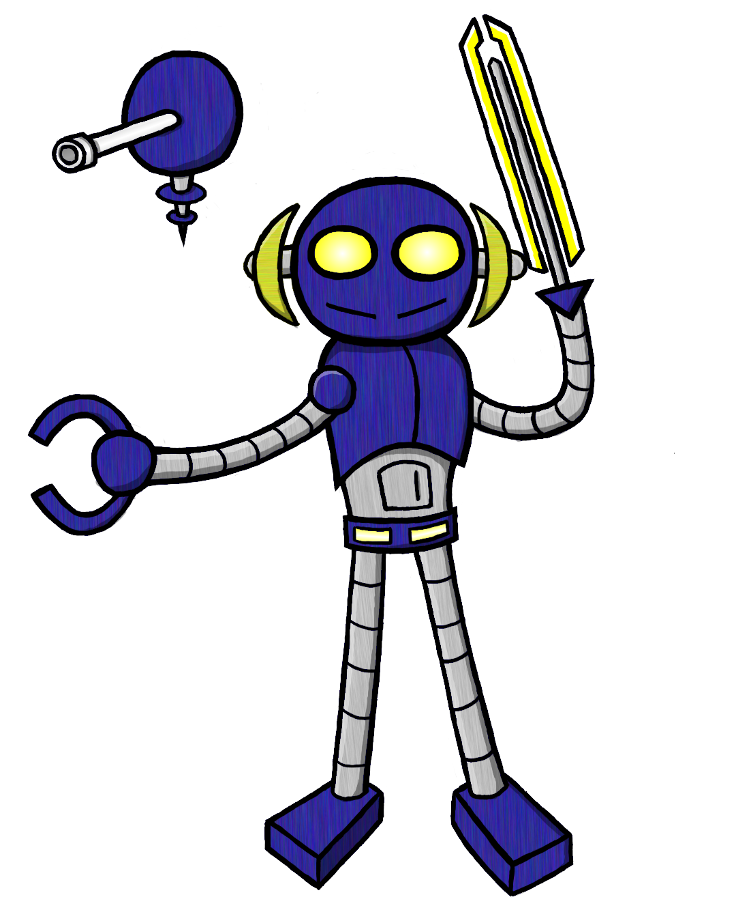
Thanks, from the robo:DU-0 Team!!!

